Slide 1
SECKC dc25 BADGE

Slide 2
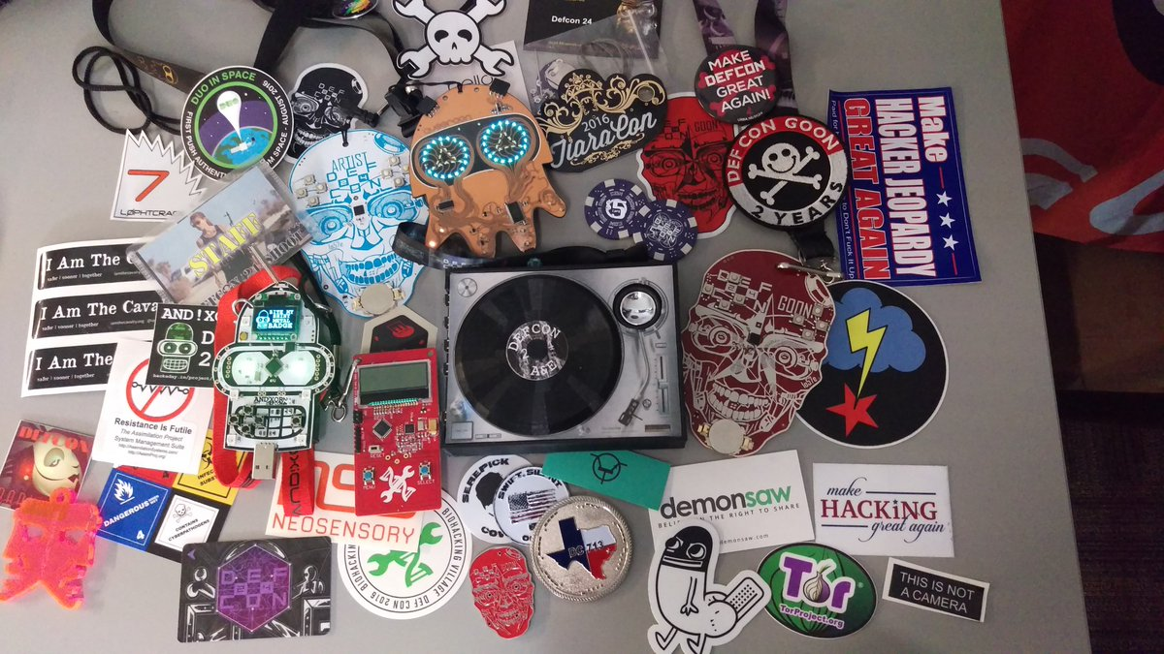
Badges Everywhere

Slide 3
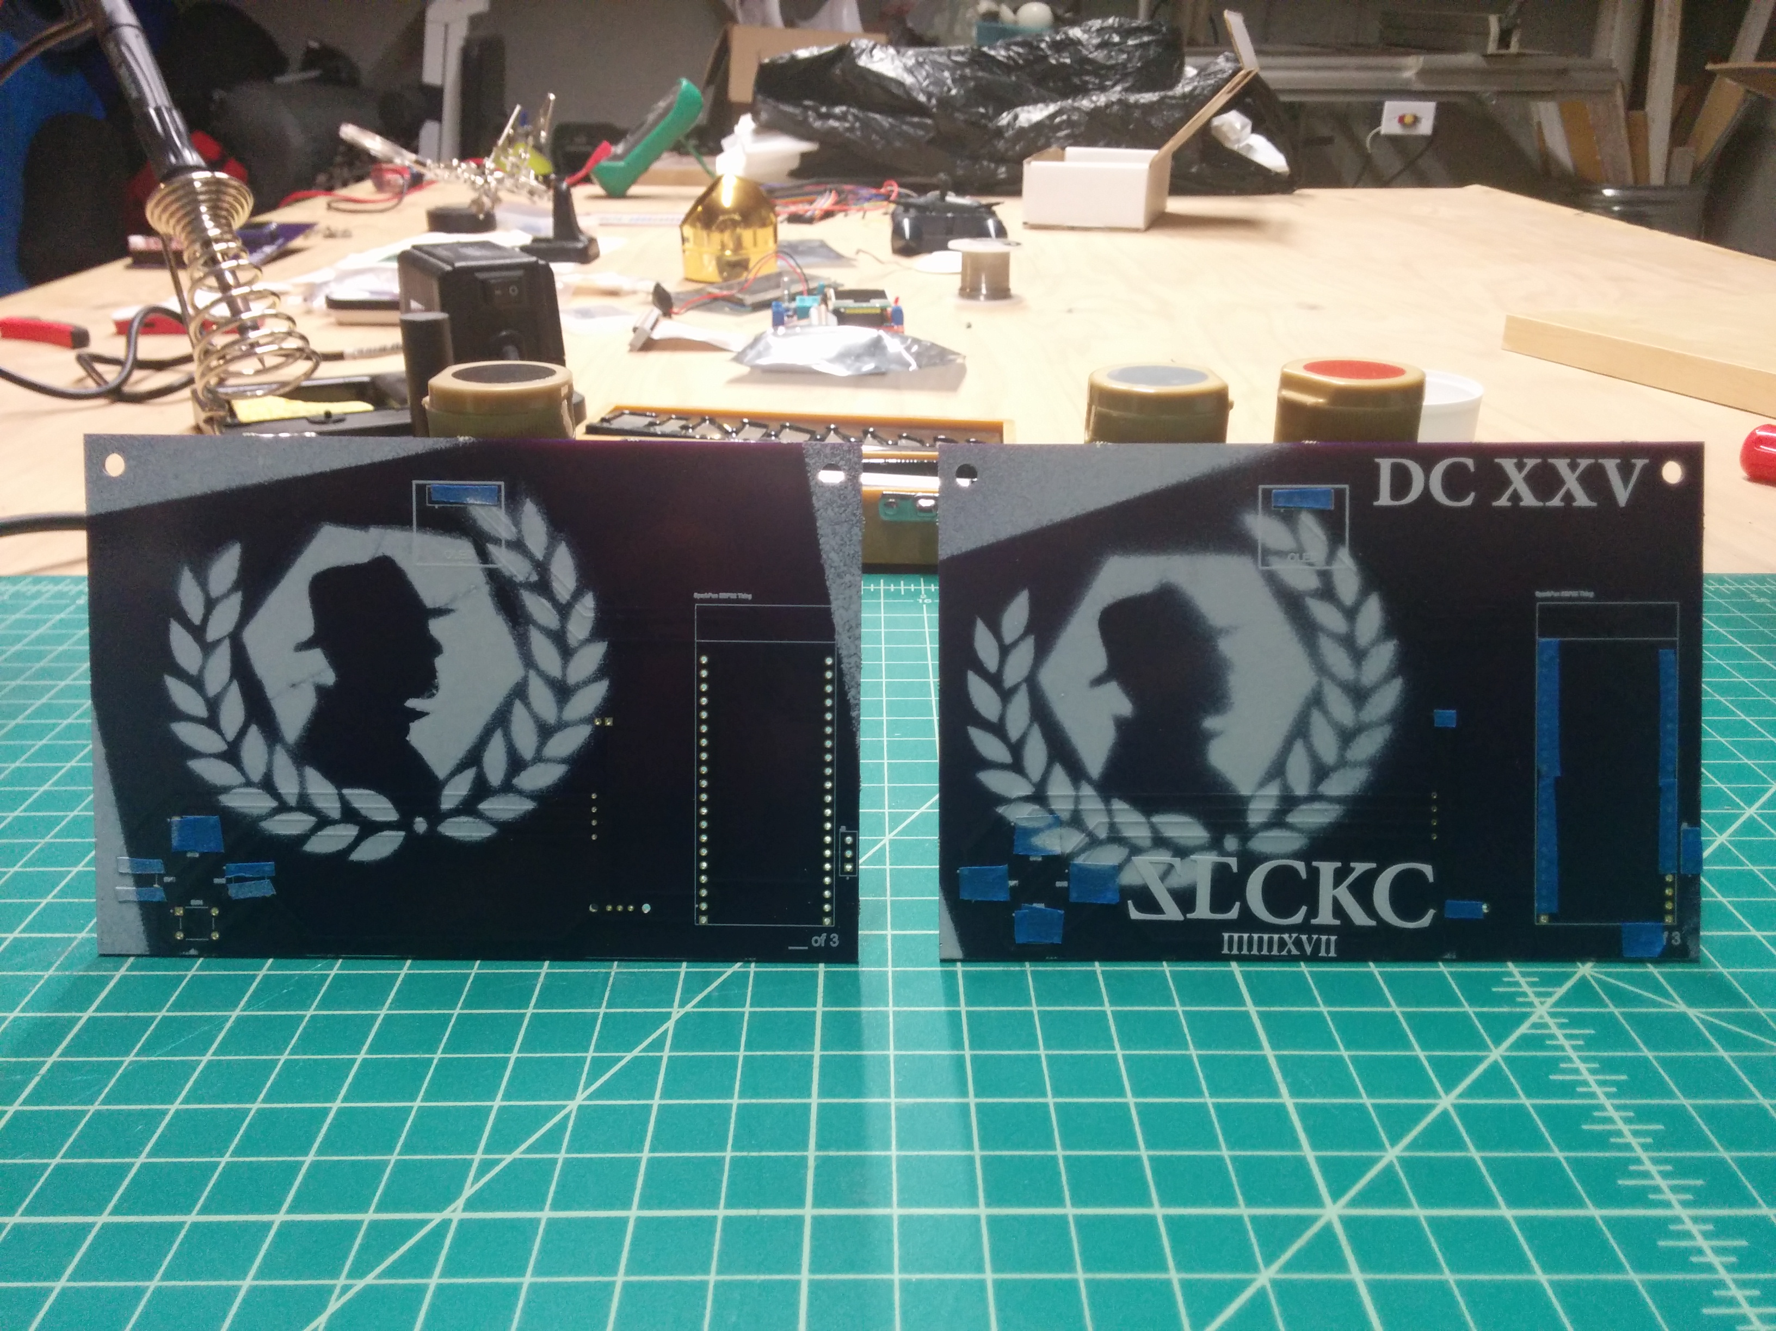
SecKC DC 25 Badge Prototype!!! Hand Painted

Slide 4
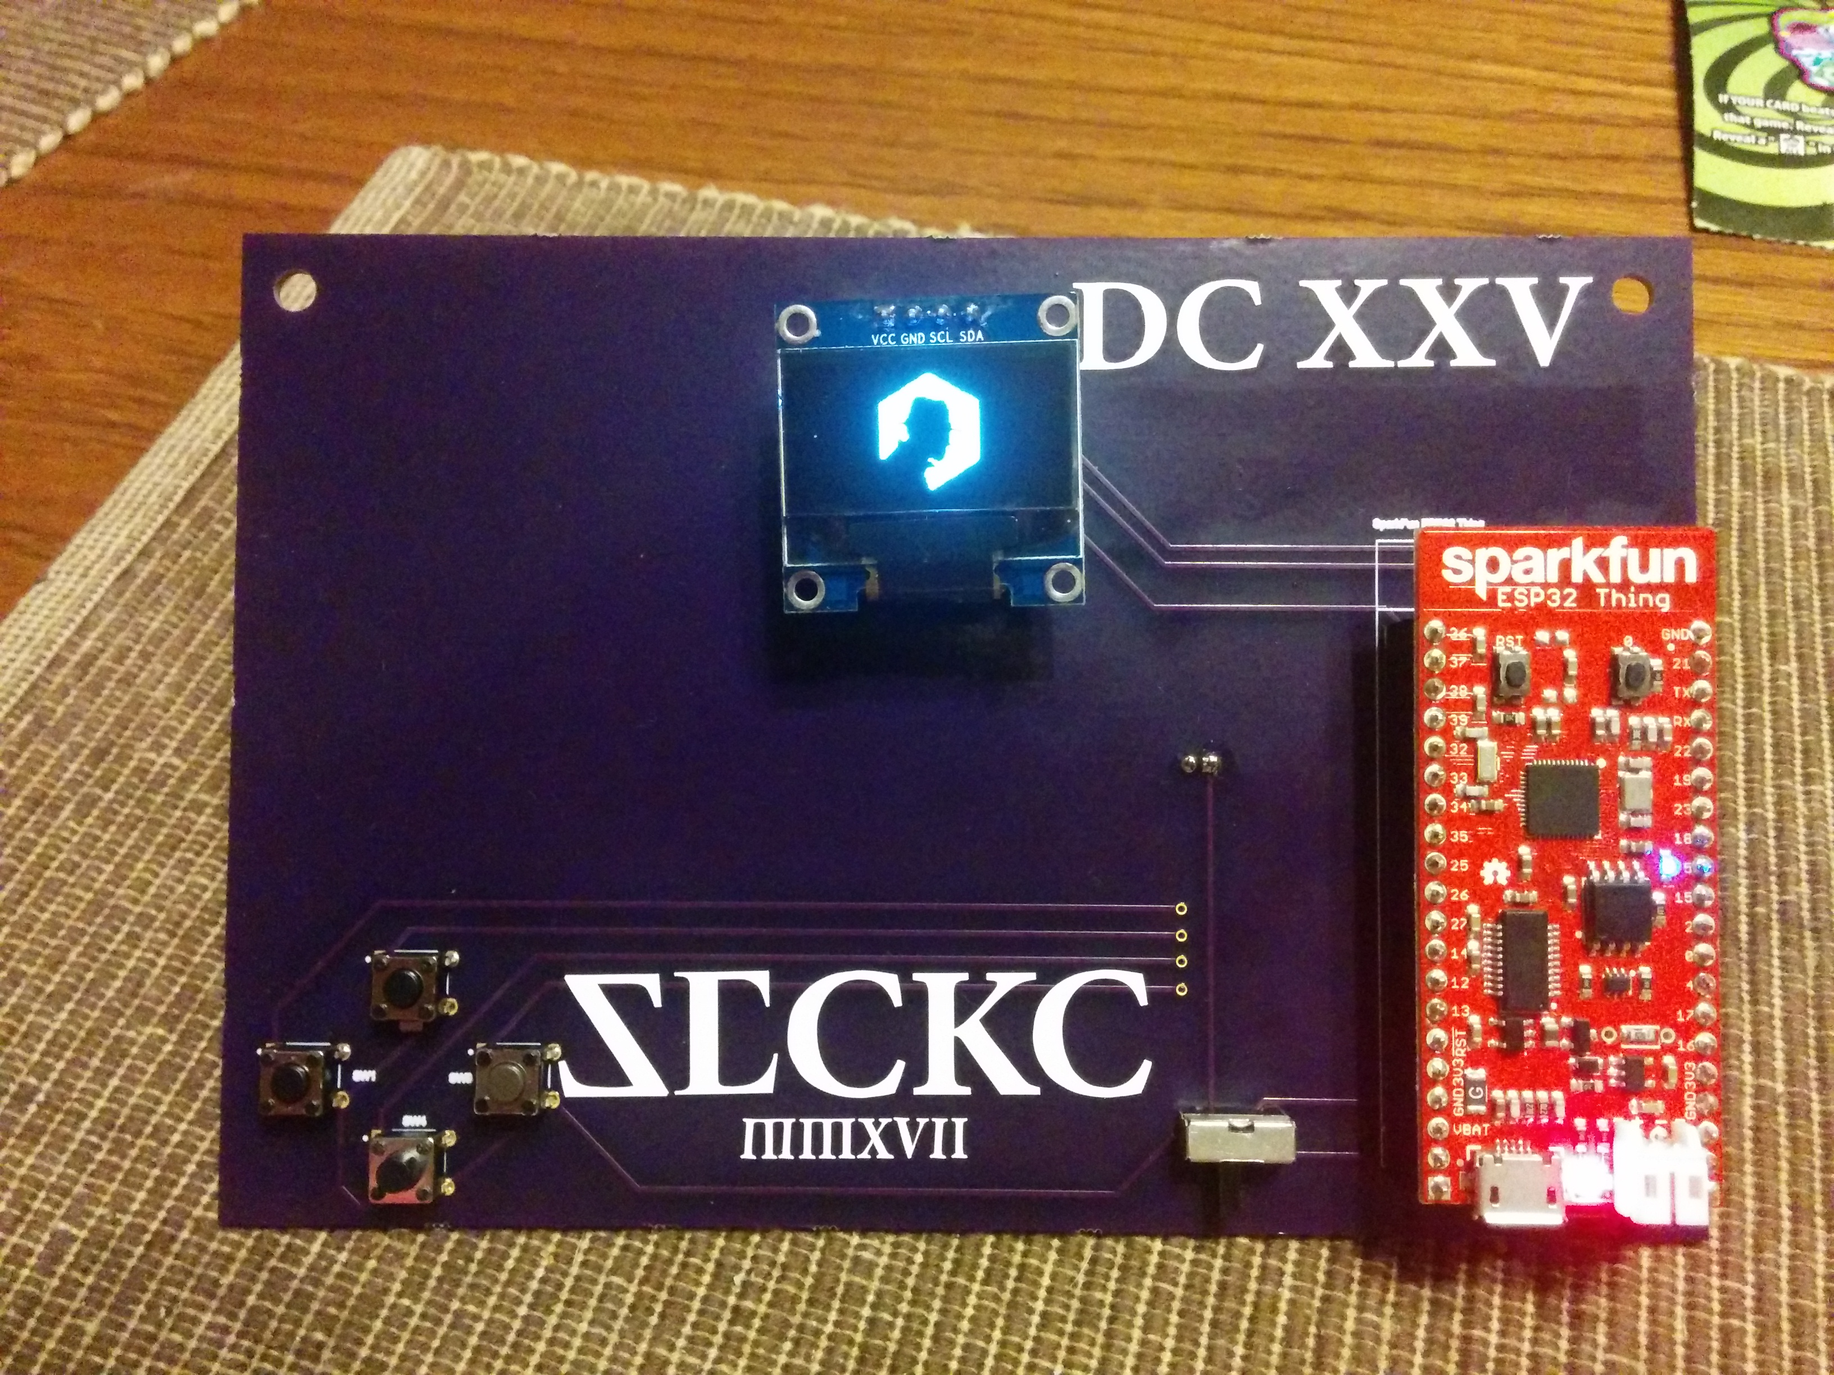
ESP32 BLE, Wifi, Lipo Charger, 30+ gpio 5 buttons , 128x64 OLED

Slide 5
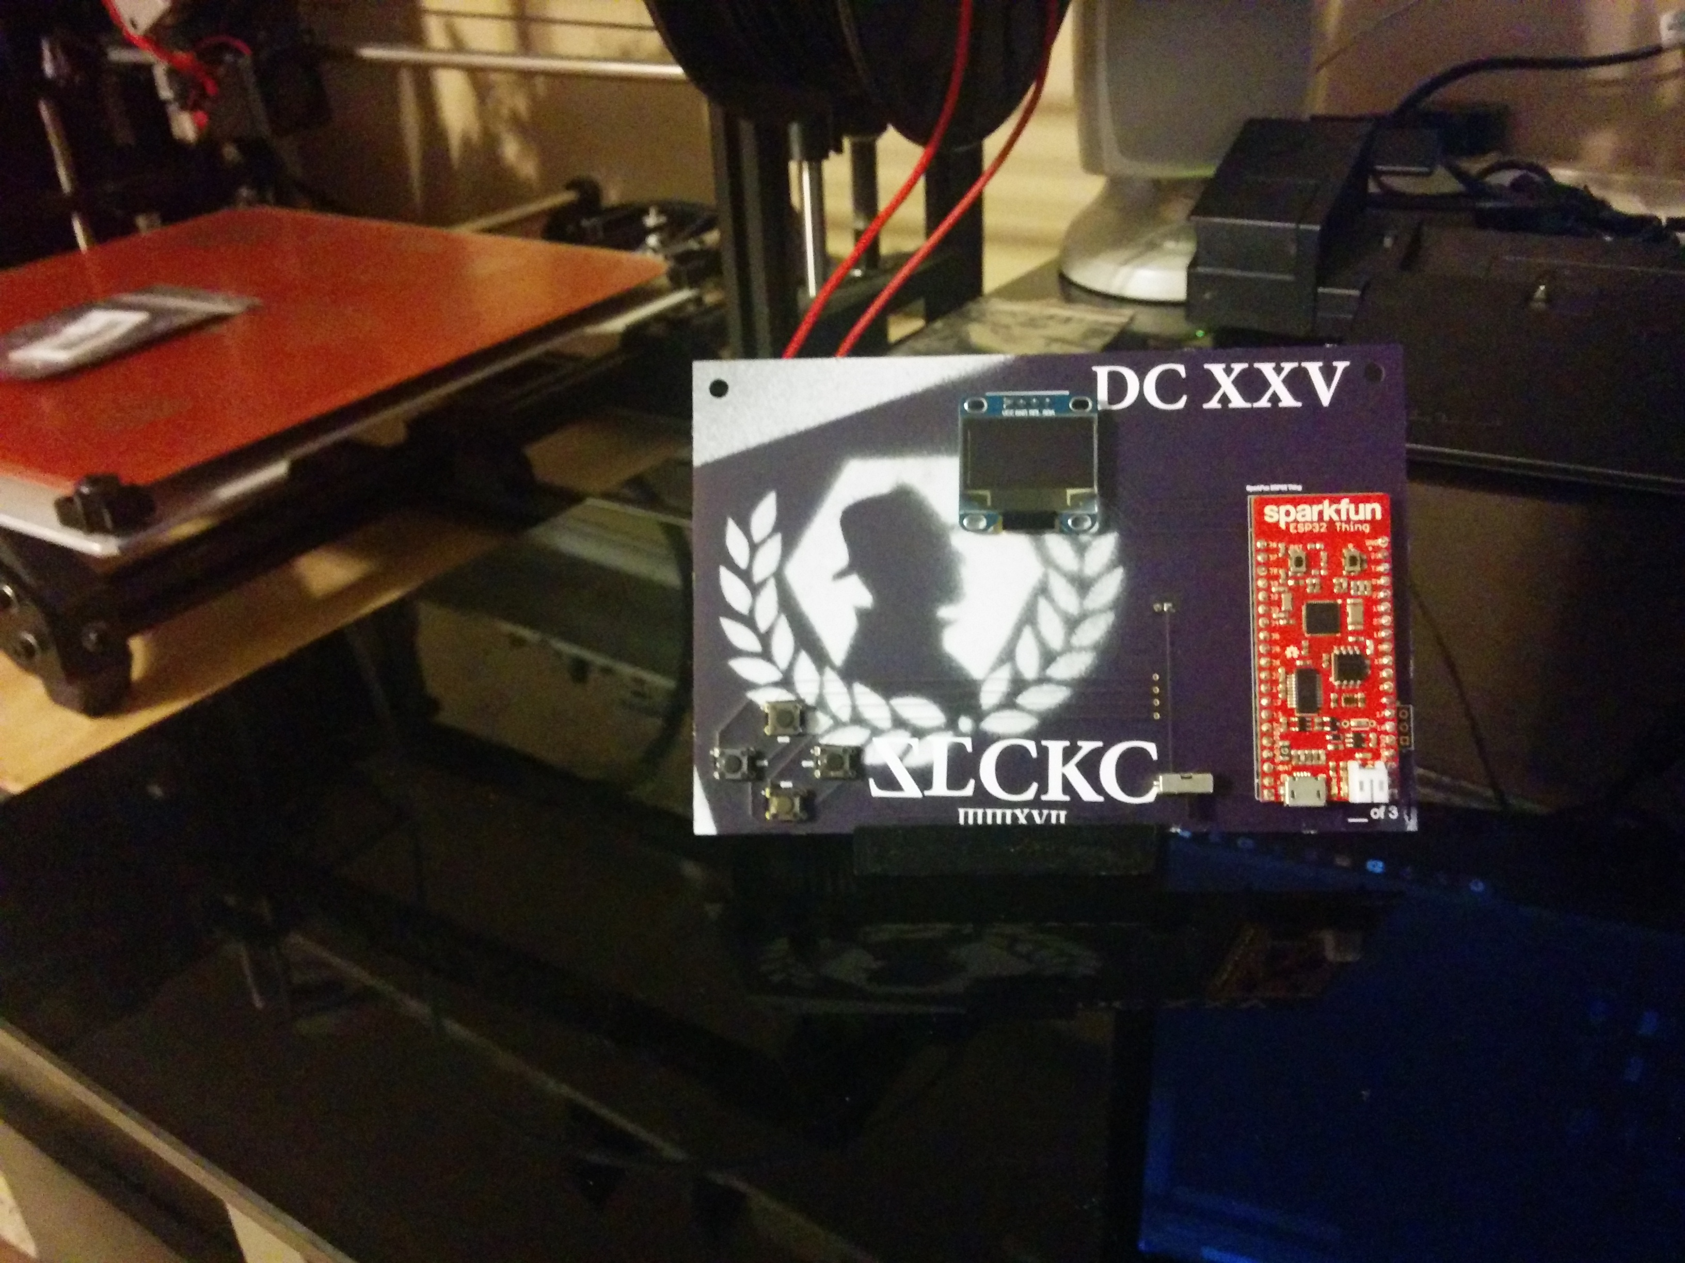
SecKC DC 25 Badge Prototype!!!

Slide 6
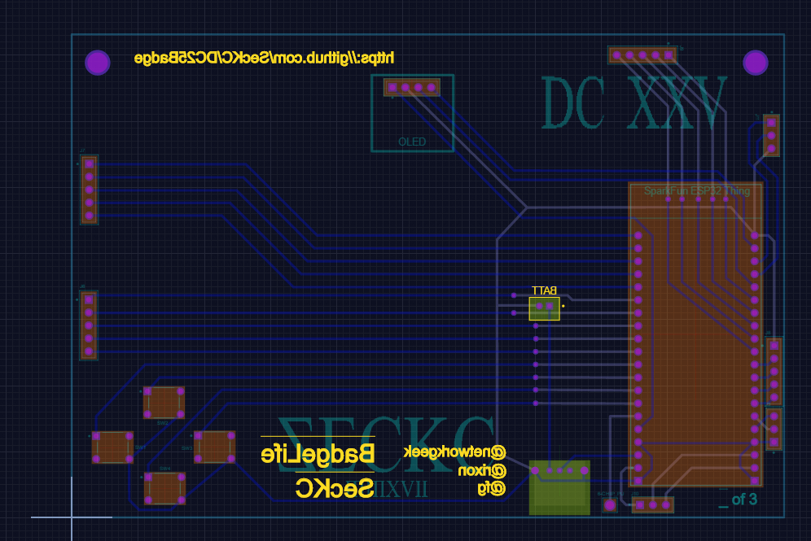
SecKC DC 25 Badge

Slide 7
Let us know so we can order
BOM Cost: about 50$
#SECKC Slack
@networkgeek
@rixon
@fg

